Slide 1
Retail spending and COVID-19
A love story in data
By Adam Van Geleuken, Jacque De Micheli and Masi Mapiye

Slide 2
Did the number of COVID cases in Australia have an impact on retail spending?
By assessing the fluctuations in COVID cases and in retail spending over the same time period we should be able to see if a pattern emerges.
Our hypothesis: spending increased during peak COVID times.
Or is there no relationship?

Slide 3
Questions we had to ask:
When did Australia officially record COVID cases?
What where the trends in COVID cases across all states?
Was there a difference in spending before and after COVID?
If yes, where certain industries more affected than others?
Where there differences in retail spending across the different states and territories?
What other factors that may skew the data do we take into consideration?

Slide 4
Data Sources
Our COVID data came from the excellent website https://www.covid19data.com.au/ in the form a pretty neat .csv file, which would also require some cleaning and organization
All retail trade data was obtained from the Australian Bureau of Statistics: https://www.abs.gov.au/statistics/industry/retail-and-wholesale-trade/retail-trade-australia/latest-release
These came in the form of Excel documents, which would require quite a bit of cleaning and formatting to make work with some of the functions in Pandas and MatPlotLib

Slide 5

Data Clean Up
Daily COVID Cases by State data – CSV file
Retail trade data – 2 x Excel Spreadsheets

Slide 6

Daily COVID Cases by State data
Converted ‘Date’ column to a datetime format
Grouped data per month
Added a column for total number of COVID cases per month in all states and territories
Added additional columns for % COVID cases in each state and territory
Calculated and added columns for % change in cases across states and territories

Slide 7

Retail trade data;
Retail Turnover by Industry Group and Retail Turnover by State spreadsheets
Changed xlsx files to CSV format
Narrowed down the dates of interest on both CSV files to 01/11/19 to 01/12/21
Removed columns not required for analysis – Trend Series data
Renamed columns
Changed formatting for the ‘Date’ column

Slide 8
Testing the waters!
We decided to see if there was any overall trends apparent in retail spending during the period COVID has been in Australia
This would be achieved with scatter plots and linear regression models
Victoria and New South Wales were chosen as they represented the states most effected by COVID. Western Australia and the Northern Territory were used as they had far less cases than the east coast.

Slide 9
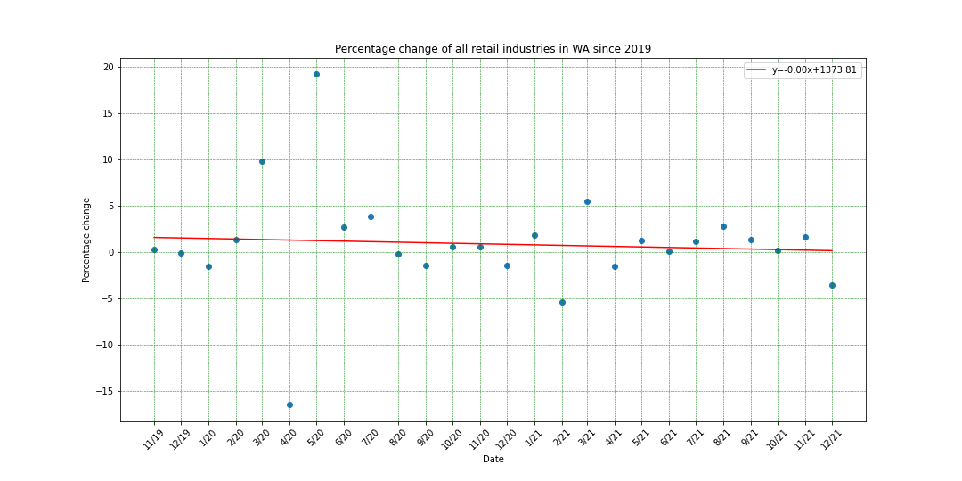
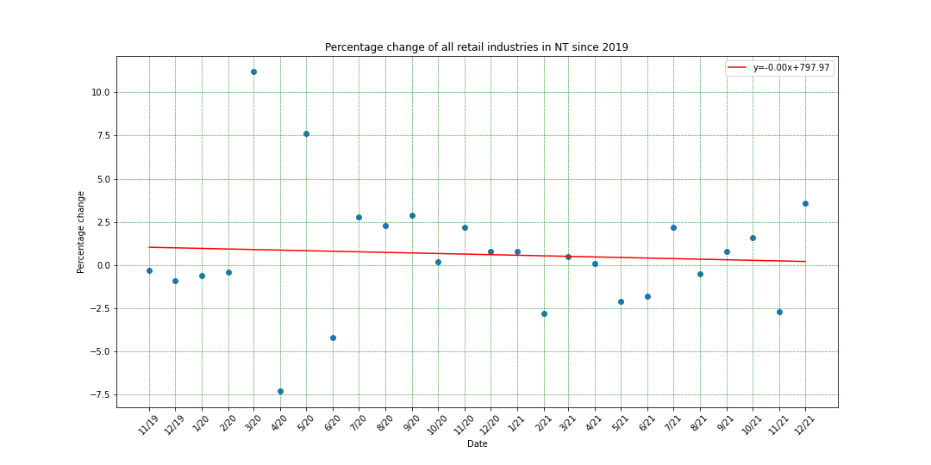
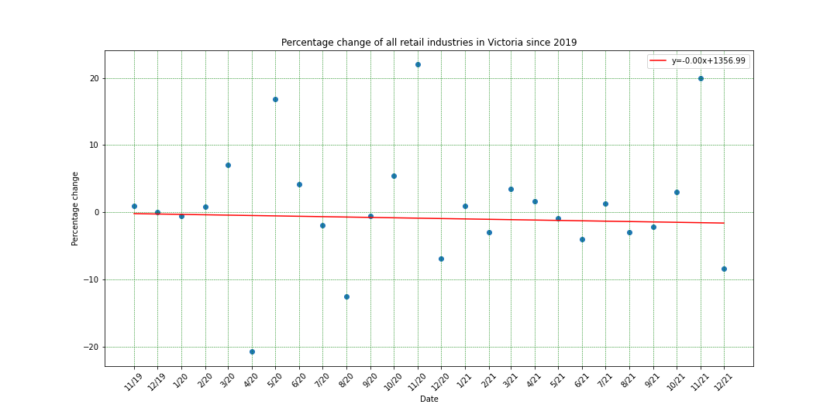
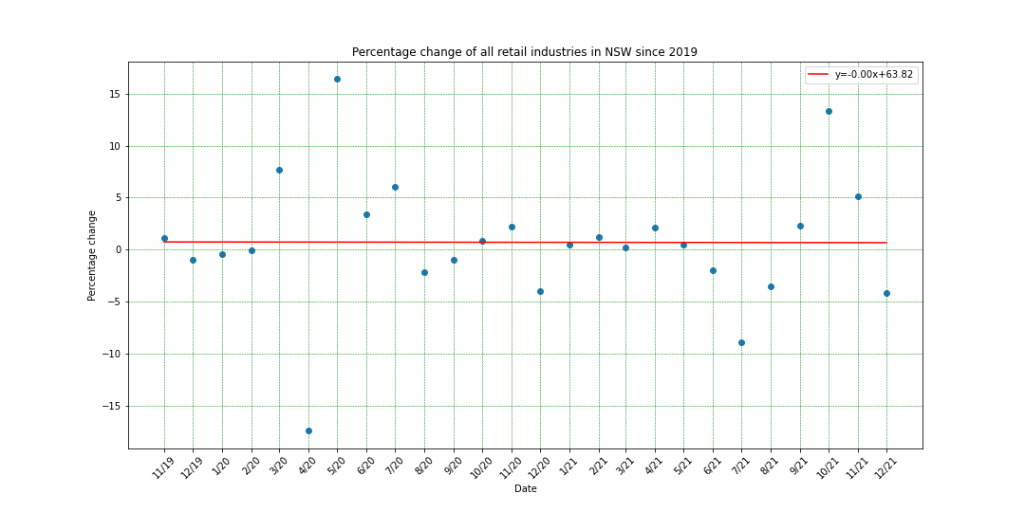

Slide 10
Not much to see there!
Nearly flat linear regression plots indicated very little change over time to our seasonally adjusted sales data.
But if we look closely, we can see that all the graphs have outliers.
Could this have something to do with COVID cases?

Slide 11
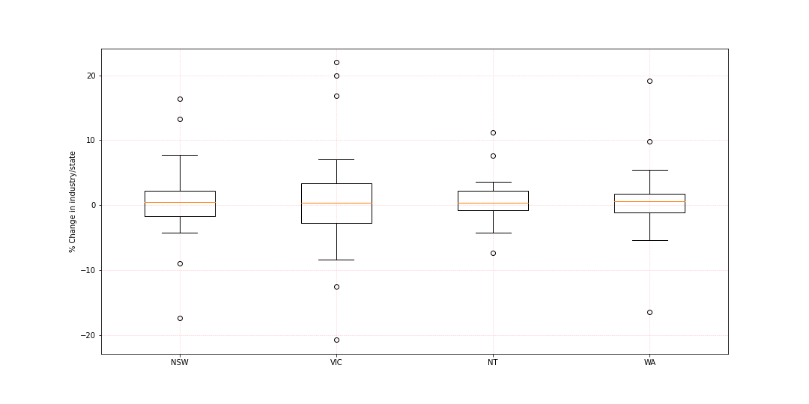
Box Plots could describe this a little easier

Slide 12
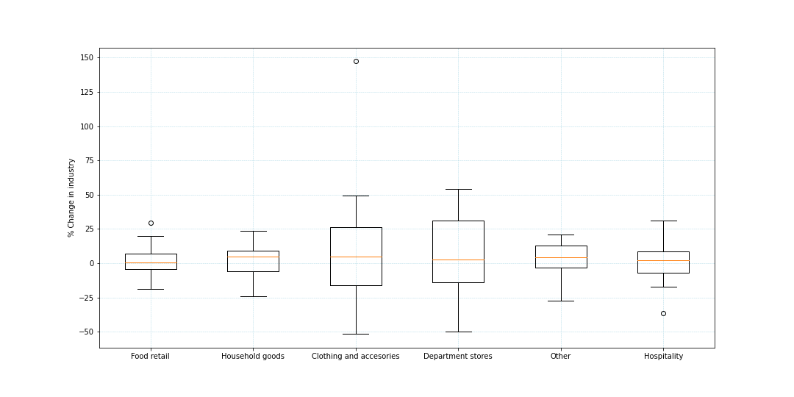
And across all industries there are outliers too

Slide 13
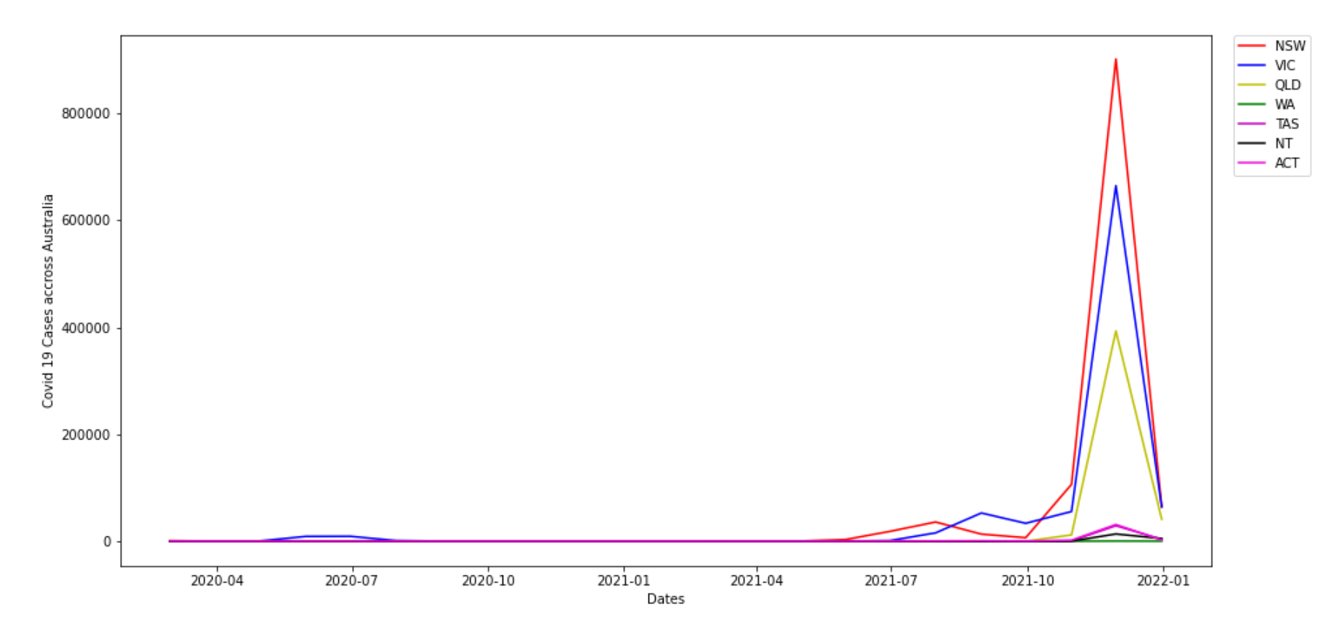
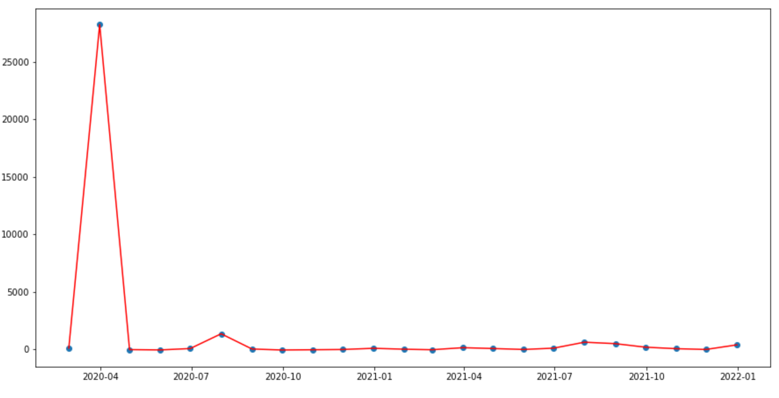
Covid 19 cases and Monthly variance % from previous month
Monthly Variance of Covid 19 cases
Period March 2020 to January 2022

Slide 14
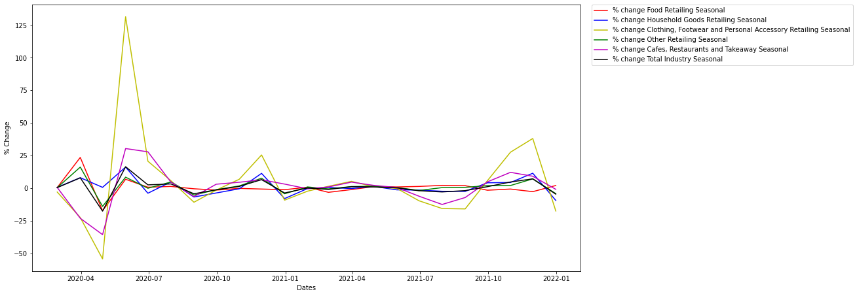
Percentage change of retail turnover (seasonal adjusted) by different type of industries nation wide
Retails in Clothing and hospitality seems to have biggest peak of variance during the analyzed period, so these will be compared to the Covid 19 dataset.
Period March 2020 to January 2022

Slide 15
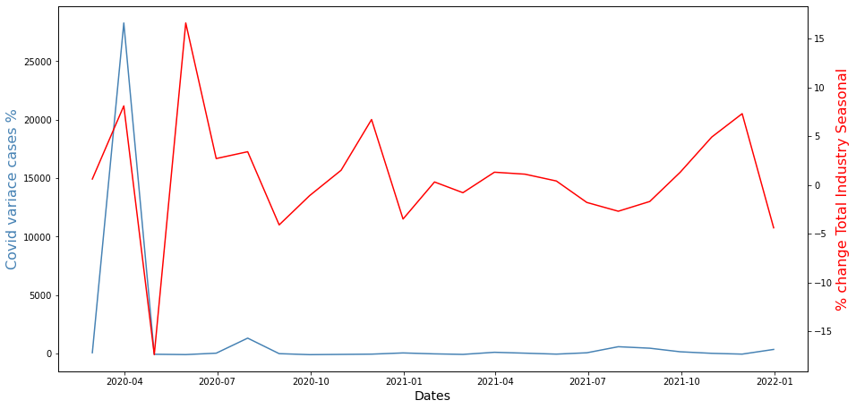
Percentage change of Total retail turnover (seasonal adjusted) with respect to monthly Covid 19 cases % variance

Slide 16
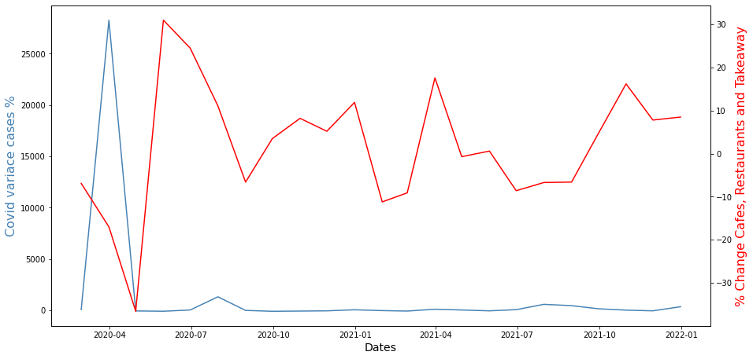
Percentage change of Café etc. retail turnover (seasonal adjusted) with respect to monthly Covid 19 cases % variance

Slide 17
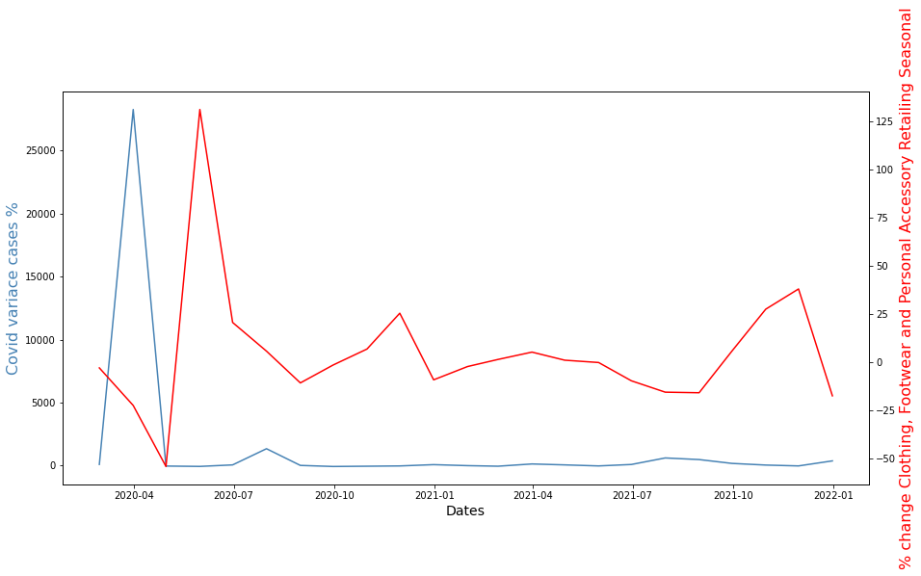
Percentage change of Clothing etc. retail turnover (seasonal adjusted) with respect to monthly Covid 19 cases % variance

Slide 18
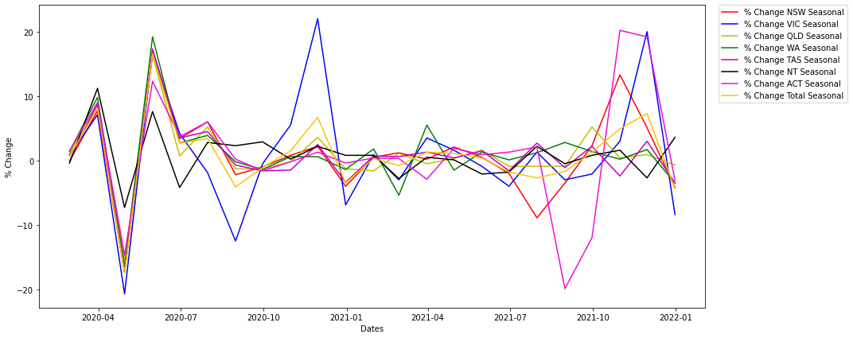
How were the retail industries affected across different states and territories during the Covid 19?
Period March 2020 to January 2022

Slide 19
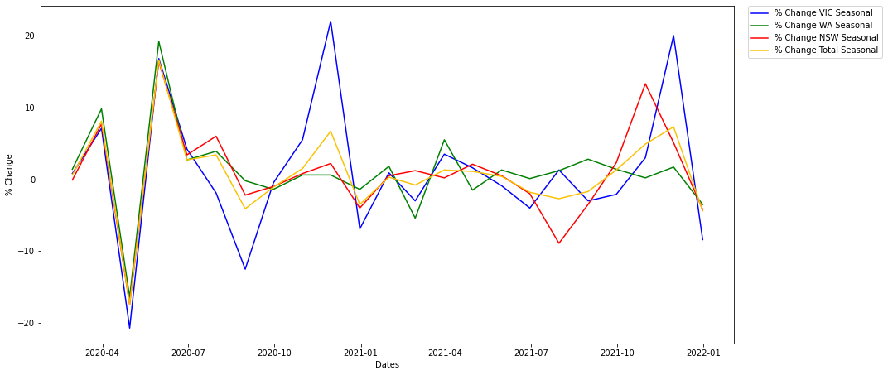
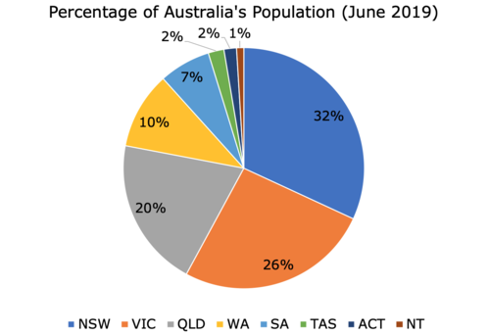
How were the retail industries affected across different states and territories during the Covid 19?
Detail for VIC WA NSW and across the nation

Slide 20
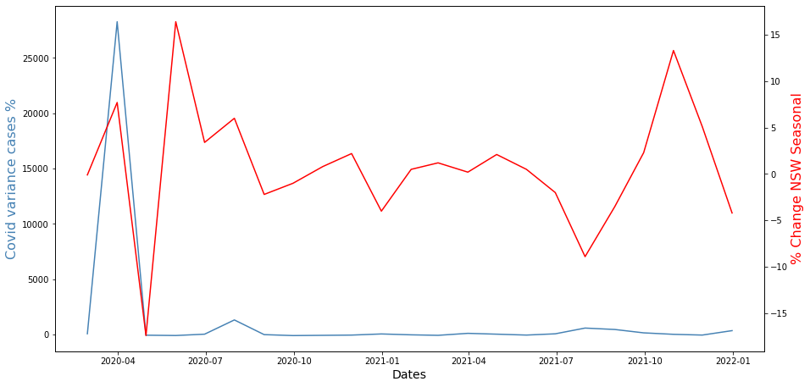
How were the retail industries affected across different states and territories during the Covid 19?
Detail for NSW

Slide 21
Research Questions Answered
When did Australia first record cases: 25 January 2020
What where the trends across all states: As case numbers rise, a large ripple effect can be seen in retail spending
Was there a difference before and after covid: Overall spending stayed relatively flat, but we can see outliers that correspond to covid case fluctuations
Where certain industries more effected than others: Yes, clothing had a large increase, and hospitality trended a bit lower
Weere there differences in retail spending states and territories: Yes, states with higher covid cases experienced higher fluctuations in spending
What other factors that may skew the data do we take into consideration: Use of seasonal adjusted data for retail spending

Slide 22
Conclusions
COVID affected retail spending in Australia
Differences observed in retail spending as COVID infections fluctuated
VIC and NSW were the most affected by COVID
WA and NT were the least affected by COVID

Slide 23
Post mortem
Difficulties – cleaning up the data
Other factors to investigate;
border closures
economic stimulus packages
If we had more time, we would zoom in on periods of lockdowns and restrictions and compare to retail spending from previous years where there was no covid. We obtained a timeline of restrictions from her: https://www.aph.gov.au/About_Parliament/Parliamentary_Departments/Parliamentary_Libr[…]21/Chronologies/COVID-19StateTerritoryGovernmentAnnouncements

Slide 24

Any Questions?

